Slide 1
Getting More Physical in
Dimitar Lazarov
Lead Graphics Engineer, Treyarch
Notes:
We started pursuing Physically Based Shading during Black Ops, details of which I presented at SIGGRAPH 2011, as part of the “Advances in Real-Time Rendering” course.
Here I’ll present a brief summary of the important aspects and then dive into improvements we made on Black Ops II.

Slide 2
Black Ops: shading model
Diffuse response
Direct: analytical lights
Indirect: lightmaps, light probes
Lambertian BRDF
Specular response
Direct: analytical lights
Indirect: environment maps
Microfacet BRDF

Slide 3

Black Ops: Microfacet BRDF
Based on Cook-Torrance:
* pl = point light
Notes:
D = normal distribution function (NDF)
F = reflectance function (Fresnel function)
G = shadowing-masking function (Geometry function)
Grouped into three “lego” pieces for easier experimentation with different formulations and approximations.
D_pl = NDF for point lights grouped with pi/4.
V = visibility function: shadowing-masking grouped with foreshortening terms.

Slide 4
Black Ops: normal distribution function
Blinn-Phong:
α: specular power
g: gloss
Energy conserving
Physically plausible stretchy highlights
Cheaper replacement for Beckmann NDF (with parameter conversion)

Slide 5
Black Ops: reflectance function
Schlick-Fresnel:
rf₀: base reflectance (specular color)
Notes:
Microfacet H-dot-L-based formulation.
Everyone seems to use this.

Slide 6
Black Ops: visibility function
Schlick-Smith:
Compared favorably to:
No visibility V(l, v, h) = 1
Cook-Torrance and Kelemen/Szirmay-Kalos (no gloss/roughness consideration)
Notes:
Schlick-Smith gave the most plausible (albeit the most expensive) specular response.
Lesson learned: very important to have high quality shadow-masking for PBS.

Slide 7
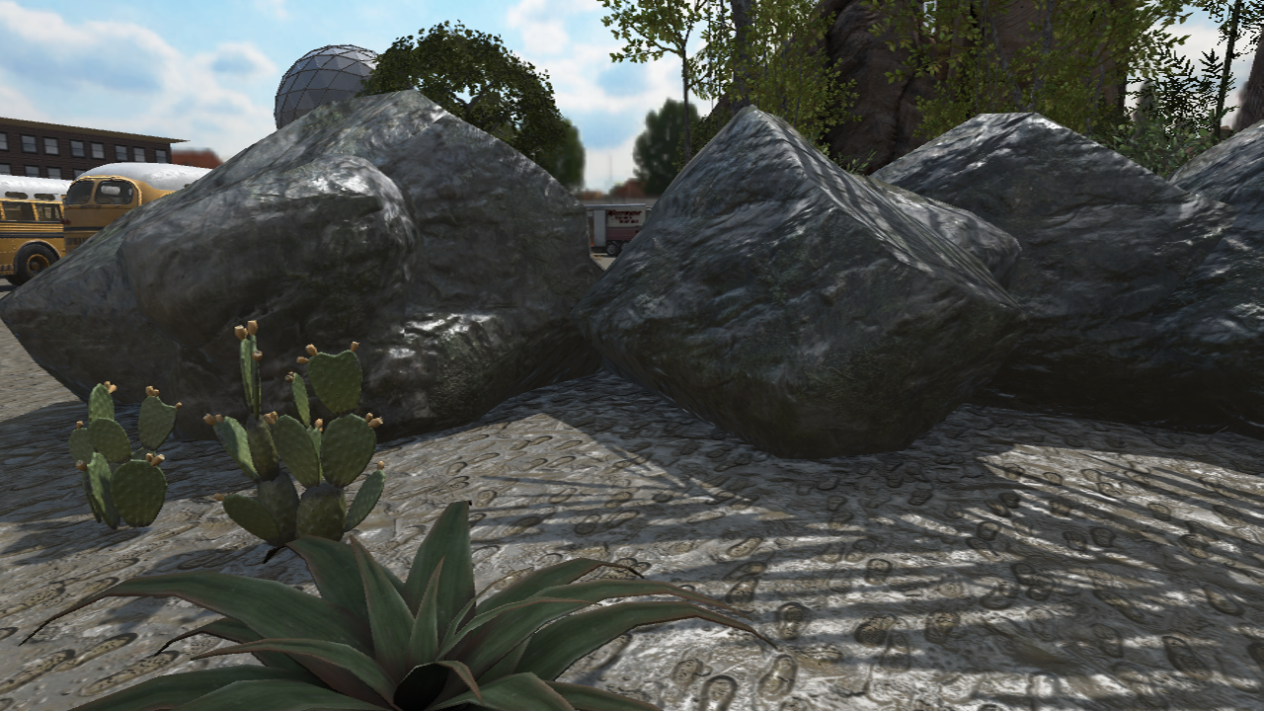
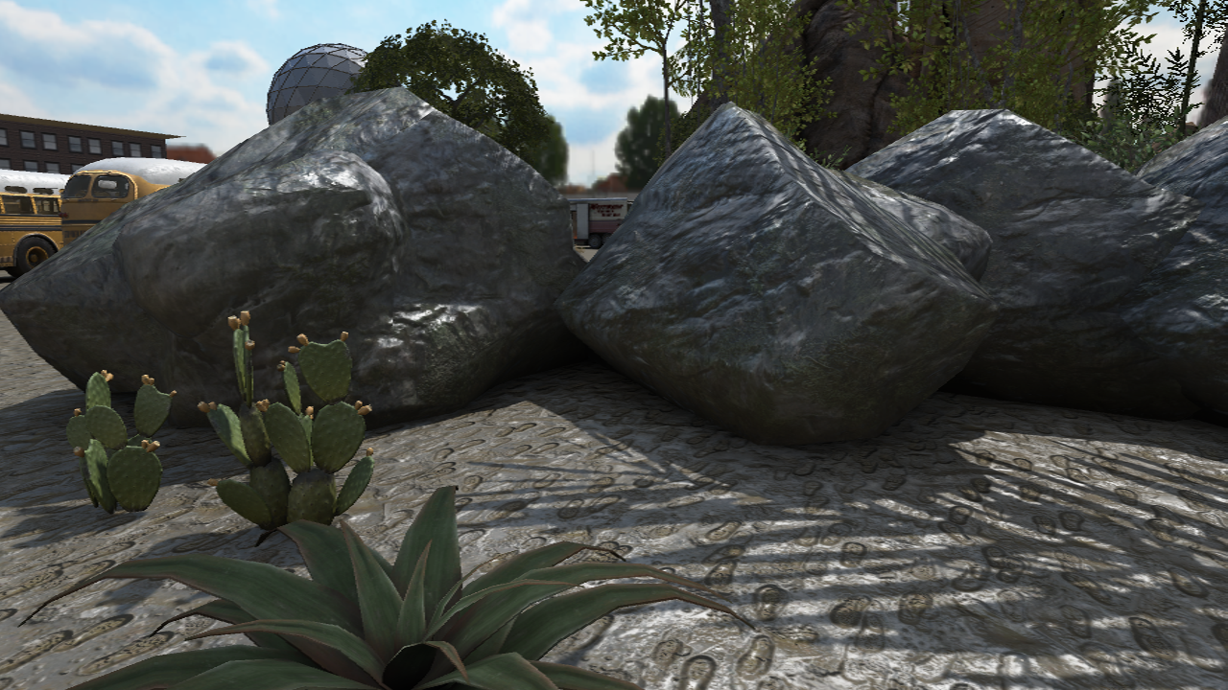
Black Ops: environment map normalization
Method to “fit” the environment map’s reflection to varying lighting conditions
Notes:
Switching gears: indirect specular via environment maps.
We capture environment maps at artist-selected locations in the level.
We wanted to use as few and as high resolution environment maps as possible.
We came up with a method that lets us better “fit” and hence “reuse” the same environment map in very different lighting environments compared to where the environment map was captured.

Slide 8
Black Ops: normalization algorithm
Offline:
env_sh9 = capture_sh9(env_pos);
env_average_irradiance = env_sh9[0];
for_each (texel in environment map)
texel /= env_average_irradiance;
Pixel Shader:
env_color = sample(env_map) * pixel_average_irradiance;
Notes:
env_sh[0] is the DC term, which is equivalent to evaluating the SH with a (0, 0, 0) direction.
pixel_average_irradiance can usually be calculated as a cheap byproduct from most forms of light baking.

Slide 9
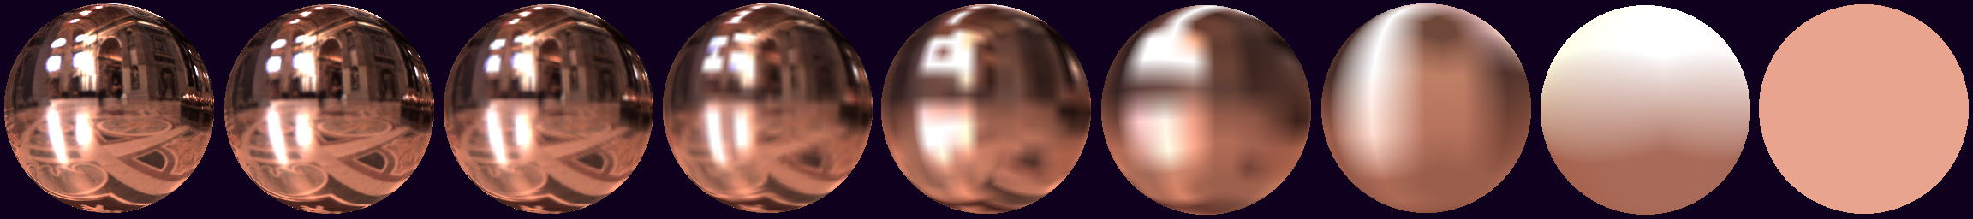
Black Ops: environment map pre-filtering
Offline, CubeMapGen
Angular Gaussian filter
Edge fixup
Pixel shader selects mip as a linear function of gloss:
texCUBElod(uv, float4(R, nMips – gloss * nMips));

Slide 10
Black Ops: environment map “Fresnel”
More than just Fresnel, included shadowing-masking factor
Early attempt at deriving an “Environment BRDF”
Notes:
Here we’re using the N-dot-V form of the Fresnel formulation.
1/(4 – 3g) acts as a shadowing-masking factor

Slide 11
Getting More Physical in Call of Duty: Black Ops II
Direct Specular
Very happy with the look
Focused on performance improvements (details in the course notes)
Indirect Specular
Various deficiencies in the Black Ops methods
The major focus of improvements

Slide 12
Environment map normalization: problem
Average irradiance: poor choice for normalization
Light probe
?
Lightmap
Notes:
The picture shows conceptually the problem through the use of colors. In practice, the problems were mostly intensity related and less often about color.
The environment map is normalized from a light probe sample (full sphere of lighting information).
However, lightmap bakes often store only a hemisphere worth of information, hence when we de-normalize the environment map we can’t compensate for the missing hemisphere.

Slide 13
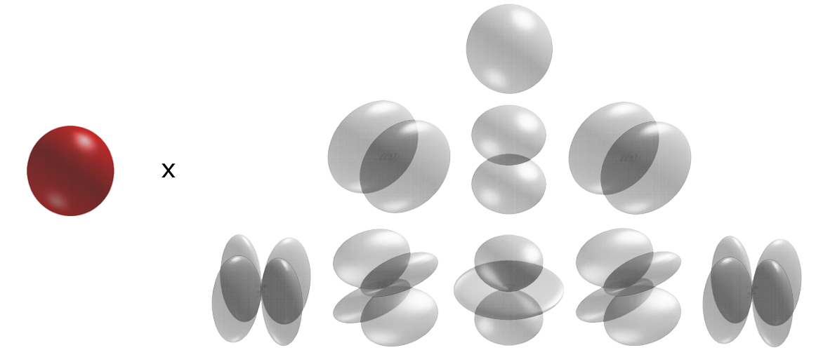
Environment map normalization: new idea
Normalize with irradiance
Can’t bake normalization offline
Pass environment map’s directional irradiance to run-time (used tinted scalar 3rd-order Spherical Harmonics)

Slide 14
Improved normalization algorithm
Offline:
env_sh9 = capture_sh9(env_pos);
Vertex Shader:
env_irradiance = eval_sh(env_sh9, vertex_normal);
Pixel Shader:
env_color = sample(env_map)/env_irradiance * pixel_irradiance;
Notes:
pixel_irradiance can usually be calculated as a cheap byproduct of most forms of light baking. It’s virtually guaranteed to exist considering geometric normal irradiance is the most important direction to reproduce correctly.

Slide 15
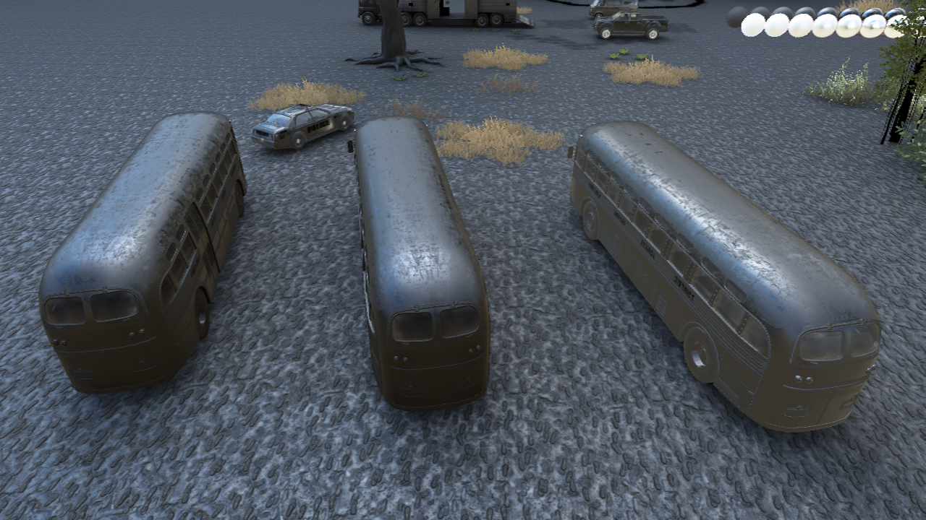
Environment map normalization: old method
Lightmap
Vertex bake
Light probe
Notes:
The same mesh with three different light bakes.
The image shows environment specular, boosted 3 stops for easier comparison.

Slide 16
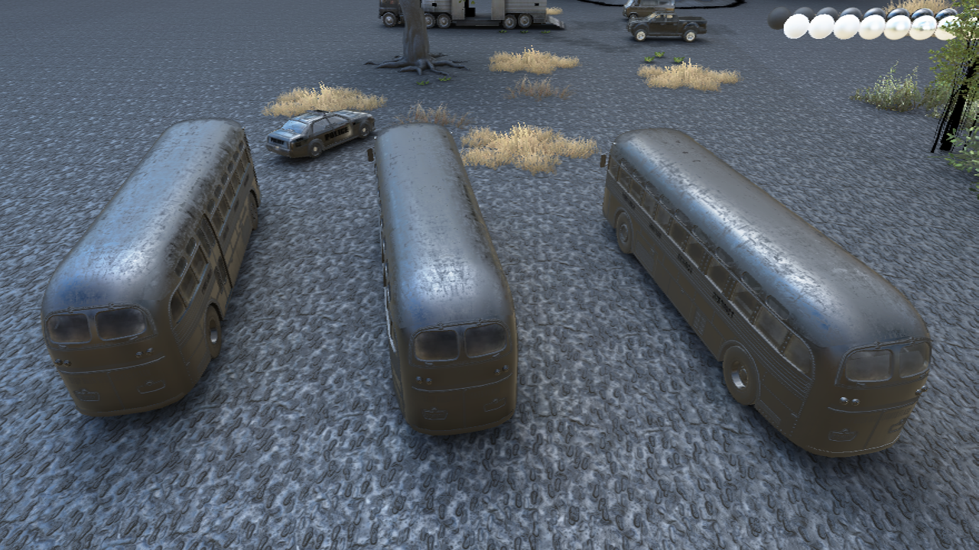
Environment map normalization: new method
Lightmap
Vertex bake
Light probe
Notes:
Notice how the specular from the different light bakes is a lot closer now.

Slide 17
Improved environment map pre-filtering
Customized CubeMapGen with cosine power filter
Concurrent work with Sébastien Lagarde
Each mip level filtered with matching gloss / specular power
Top mip “resolution” tied to max specular power
Dropped environment map resolution from 256x256 to 128x128
Blinn-Phong to Phong specular power conversion:
α_{phong} = α_{blinn-phong} / 4
Notes:
The Black Ops pre-filtering used a Gaussian, which was not an exact match to our cosine power distribution function.

Slide 18
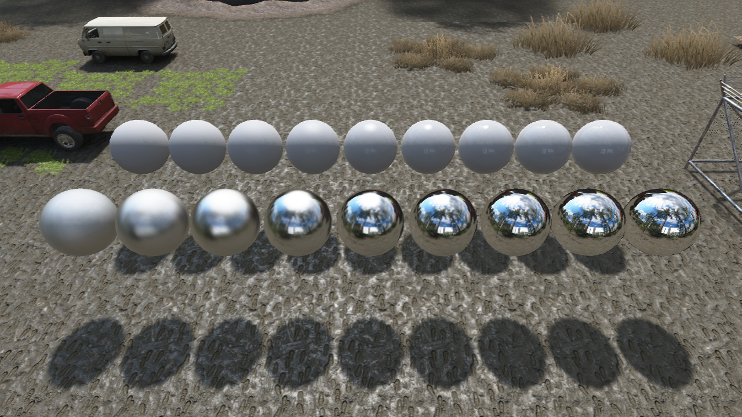
Environment map pre-filtering: old method
sun hotspot
gloss 0.0
gloss 0.5
gloss 1.0

Slide 19
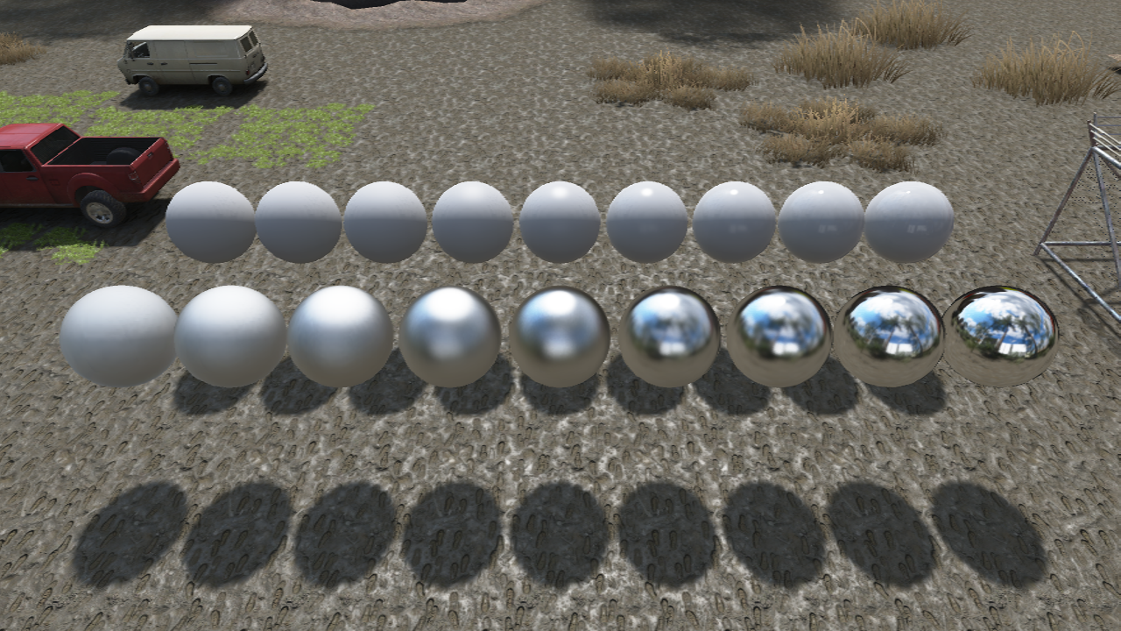
Environment map pre-filtering: new method
sun hotspot
gloss 0.0
gloss 0.5
gloss 1.0
Notes:
Notice how the environment map blurs much more linearly across the gloss range.
Also notice how the environment blur is a closer match to the sun hotspot diffusion.

Slide 20
Environment lighting: ground truth
Environment lighting integral
Notes:
Before we talk about how we improved the Environment BRDF, let’s talk about what we’re trying to solve first.
One option for solving this integral is to importance sample the environment map and the BRDF in the pixel shader. This is very expensive, but it’s a good ground truth.
Note that the environment NDF has a division by pi, as opposed to the point-light NDF which does not.

Slide 21
Environment lighting: split approximation
Split the integral: easier to calculate the parts separately
Environment map filtering
Environment BRDF
(also referred to as “Ambient BRDF”)
Approximate with mip map pre-filtering
Approximate with cheap analytical expressions
Notes:
Environment BRDF: conceptually you can think of it as the BRDF result for a white environment map.

Slide 22
Environment BRDF: reflectance interpolation
From the Fresnel formulation:
rf₀ = 1
rf₀ = 0

Slide 23
Numerical integration in Mathematica
Plotted two sets of ground-truth curves for rf₀ = 0 and rf₀ = 1
Each set contained curves for gloss values 0.0, 0.2, 0.4, 0.6, 0.8 and 1.0
rf₀ = 0
rf₀ = 1
Notes:
On the x-axis we plot N-dot-V, where rf0 is to the right, glancing angles are to the left.

Slide 24
Approximate curves: accurate
rf₀ = 0
rf₀ = 1
* HLSL expressions in the course notes
Notes:
We fitted curves by trial and error, using Mathematica to guide the process.

Slide 25
Approximate curves: cheaper
rf₀ = 0
rf₀ = 1
* HLSL expressions in the course notes
Notes:
We deployed the “cheaper” curves, with good visual results. However, we needed even cheaper expressions.

Slide 26
Focus on rf₀ = 0.04
Needed faster approximations
We had a special-case “simple” material (dielectric only) with a hardcoded specular color of 0.04
Most of our environment specular problems revolved around dielectrics
Metals looked good even with the cheapest approximations:
float a1vf(float g)
{
return 0.25 * g + 0.75;
}

Slide 27
Approximate curves: rf₀ = 0.04
float a004(float g, float NoV)
{
float t = min(0.475 * g, exp2(-9.28 * NoV));
return (t + 0.0275) * g + 0.015;
}
g = 0.0, 0.5, 1.0

Slide 28
Final approximation
float a0r(float g, float NoV)
{
return (a004(g, NoV) - a1vf(g) * 0.04) / 0.96;
}
float3 EnvironmentBRDF(float g, float NoV, float3 rf0)
{
float4 t = float4(1/0.96, 0.475, (0.0275 - 0.25*0.04)/0.96, 0.25);
t *= float4(g, g, g, g);
t += float4(0, 0, (0.015 - 0.75*0.04)/0.96, 0.75);
float a0 = t.x * min(t.y, exp2(-9.28 * NoV)) + t.z;
float a1 = t.w;
return saturate(a0 + rf0 * (a1 – a0));
}
Notes:
This is what we shipped with.
It was actually faster than the Black Ops Environment “Fresnel”.

Slide 29
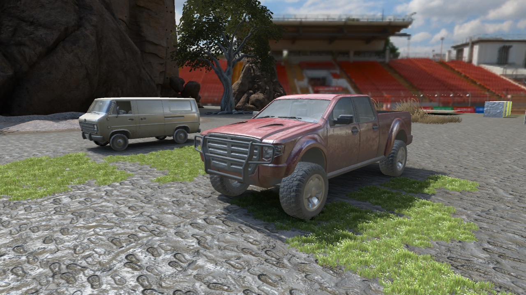
Environment BRDF: old method

Slide 30
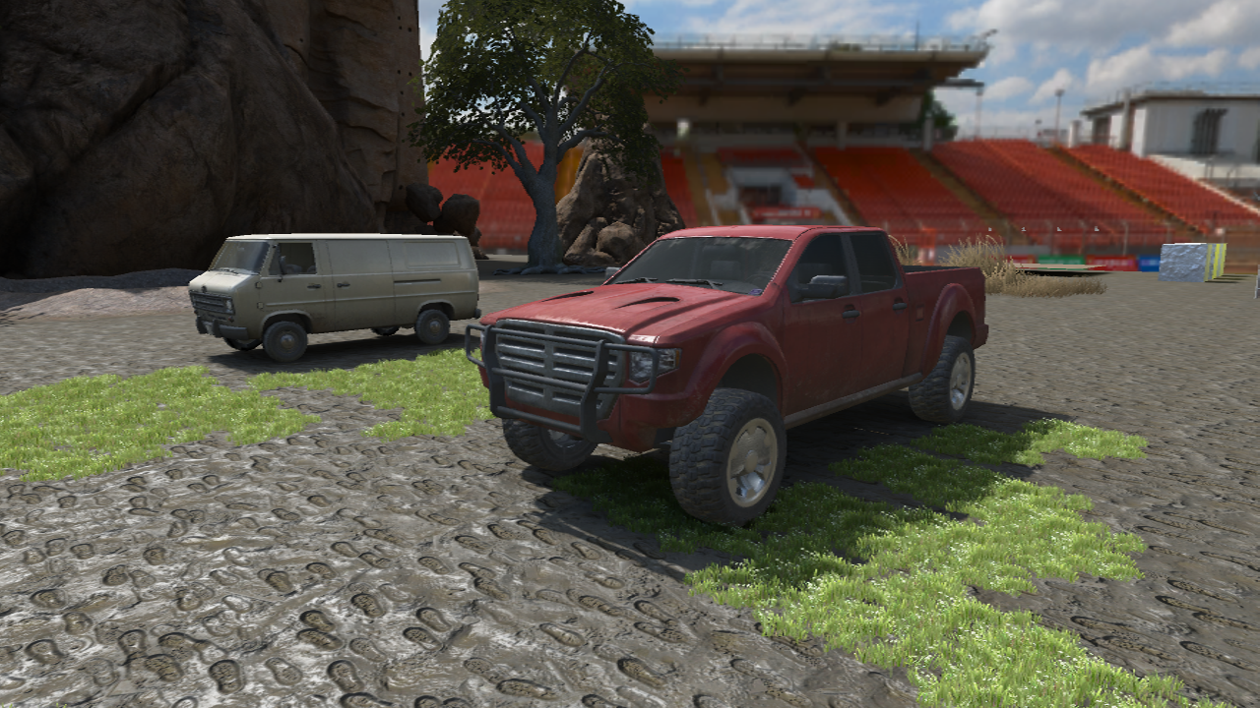
Environment BRDF: new method
Notes:
Notice the much more natural looking specular on the shadowed side of the truck.
The car paint is a dielectric material (non-metallic paint).

Slide 31
Acknowledgments
Naty Hoffman
Marc Olano
Jorge Jimenez
Sébastien Lagarde
Stephen Hill & Stephen McAuley
The team at Treyarch

Slide 32
We are hiring
You can find a list of our open positions at www.activisionblizzard.com/careers. Here is just a sample of what Treyarch currently has available:
Senior Graphics Engineer
Senior Concept Artist-Vehicles/Weapons
Senior Artist-Vehicles/Weapons
Technical Animator

Slide 33
Bonus slides

Slide 34
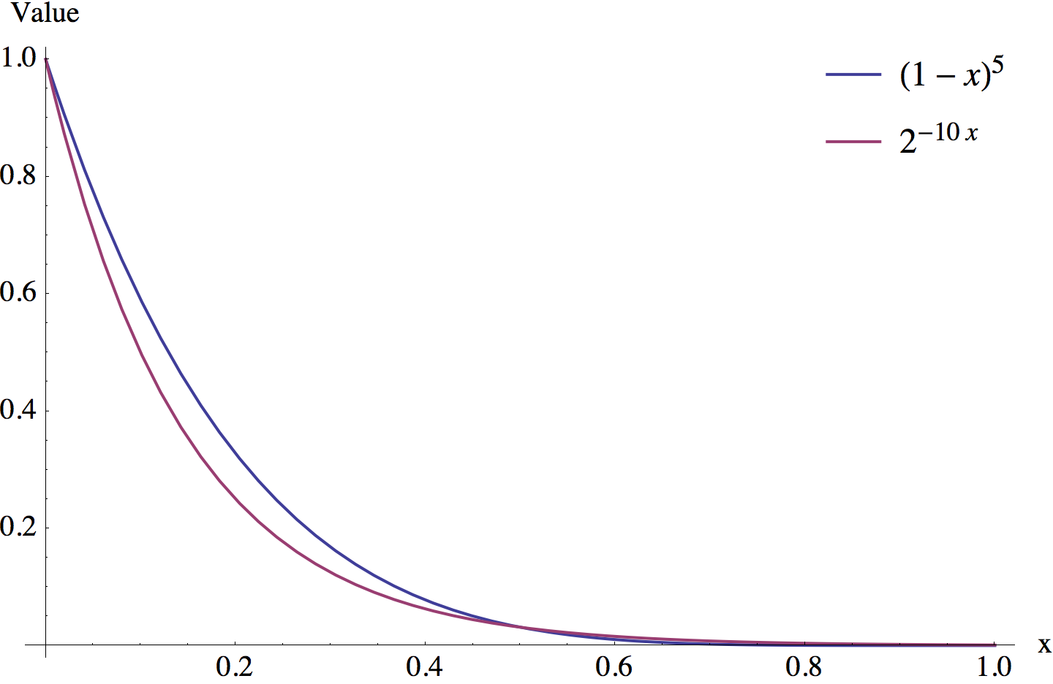
Black Ops II: new Fresnel approximation
Used Mathematica to fit candidate curves
Notes:
Note: this is to approximate the (1 – H-dot-L)^5 part of Schlick’s Fresnel function.

Slide 35
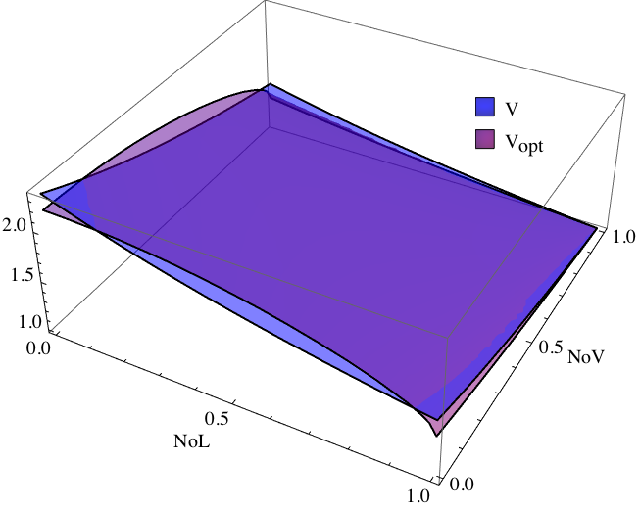
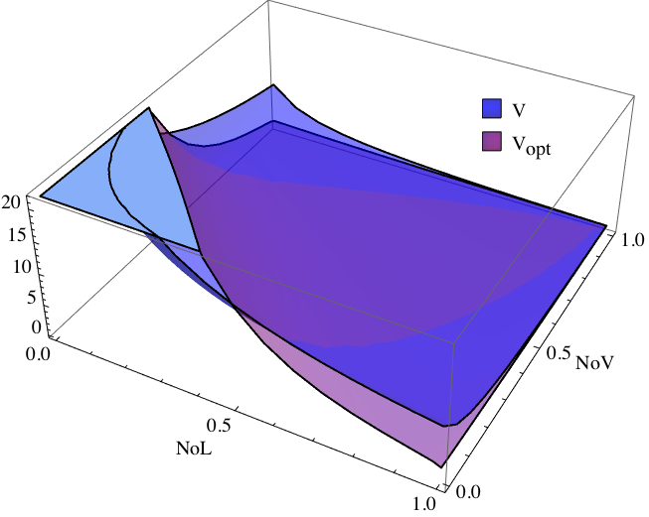
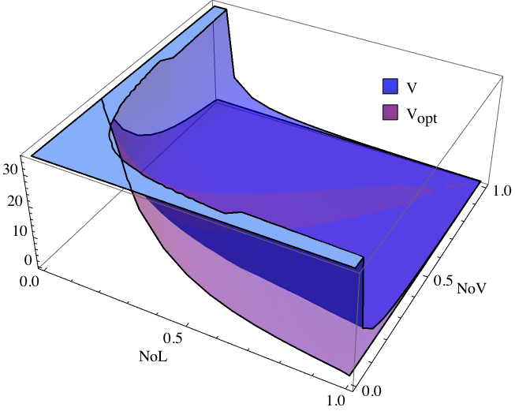
Black Ops II: new visibility function approximation
Visually matched in game (not an exact fit, but much faster)
g = 0.0
g = 0.5
g = 1.0

